Slide 1
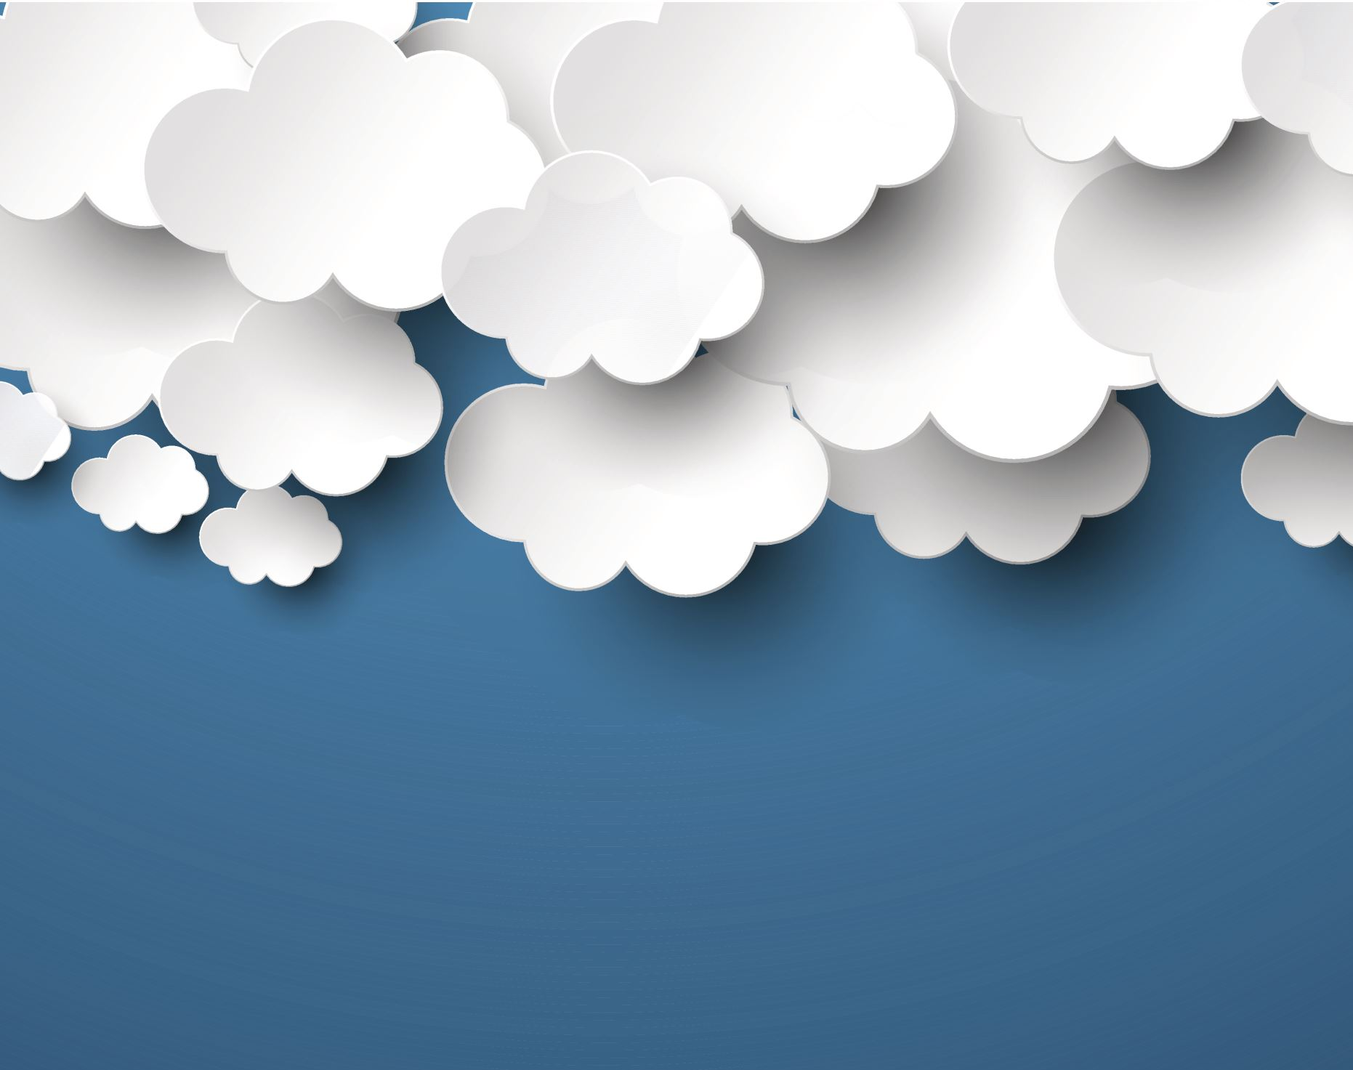
AWS Cloud Development Kit
The AWS Cloud Development Kit (AWS CDK) is an open-source software development framework to define your cloud application resources using familiar programming languages.

Slide 2
AWS CDK
Sensible, secure defaults via constructs but full power of base CloudFormation when needed
Easy learning curve using simple constructs in your familiar
Power of programming languages – parameters, conditions, loops, inheritance, composition
Better with your IDE, earlier compilation error detection and guided programming
Customizable, shareable, reusable – have your application code and infrastructure code in one place and language
Use better engineering practices – unit tests, code reviews, shared code libraries
No context switching
Faster cloud development - 1000’s lines of code less than typical CloudFormation

Slide 3
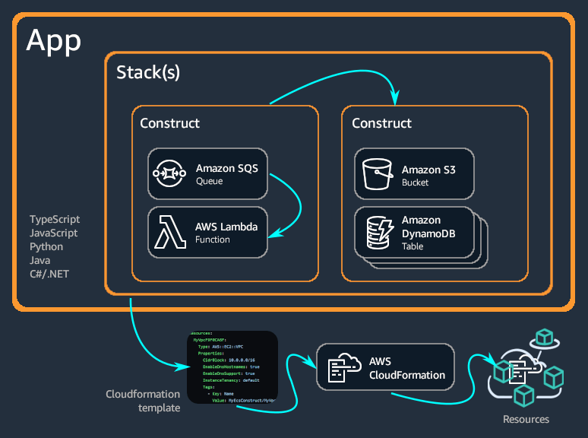
Apps, Stacks and Constructs
Developers can use one of these supported programming languages to define reusable cloud components known as Constructs. You compose these together into Stacks and Apps.

Slide 4
Layer 1, Layer 2, Layer 3 Constructs
There are three different levels of constructs
L1 -low-level constructs, which we call CFN Resources (short for CloudFormation). Represent all resources available in AWS CloudFormation.
L2 - a higher-level, intent-based API. They provide the defaults, boilerplate, and glue logic you'd be writing yourself with a CFN Resource construct.
L3 - called patterns. Designed to help complete common tasks in AWS, involving multiple resources.

Slide 5
The one liner use case that blew my mind…
Usually creating an EKS stack in CloudFormation takes a lot of work with over 1000 lines of yaml
Using the following L3 construct in java:
In a nutshell:
A VPC with optimized subnets, correct CIDR size, Security Groups etc.
EKS / Kubernetes Cluster - The cluster endpoint created by EKS.
Managed Node Group - EC2 worker nodes managed by EKS.
Fargate Profile - Fargate worker nodes managed by EKS.
Auto Scaling Group - EC2 worker nodes managed by the user.
KubectlHandler - Lambda function for invoking kubectl commands on the cluster - created by CDK.
ClusterHandler - Lambda function for interacting with EKS API to manage the cluster lifecycle - created by CDK.
Correct IAM and RBACK roles and permissions for me as the stack creator

Slide 6
Let's get started
Install CDK via npm:
npm install -g aws-cdk
Initialize a new CDK project.
cdk init --list
cdk init sample-app --language java
Compile and synthesize your CDK stack to CloudFormation
cdk synth
List all CDK stacks in project
cdk ls

Slide 7
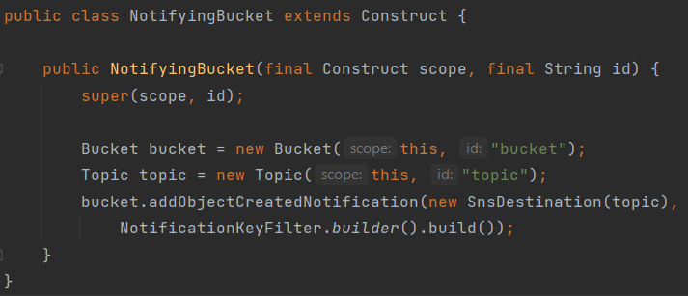
Cognito Custom Constructs
You can create your own custom CDK constructs. Reusable and sharable.
You can use third party custom constructs
To declare a new construct, create a class that extends the Construct base class
To use the custom constructor

Slide 8
Useful Cognito Resources
Use the AWS CDK API Reference documentation to see all CDK constructs and see the Developer Guide
https://docs.aws.amazon.com/cdk/api/v2/
Use constructor hub to see third party constructs. You can search AWS CDK, CDK8s, CDKtf constructs to use.
https://constructs.dev/
Check the AWS CDK workshop
https://cdkworkshop.com/

Slide 9

AWS CDK Pipelines
CDK Pipelines is a construct library module for painless continuous delivery of AWS CDK applications. Whenever you check your AWS CDK app's source code into AWS CodeCommit, GitHub, or CodeStar, CDK Pipelines can automatically build, test, and deploy your new version.
CDK Pipelines are self-updating: if you add application stages or stacks, the pipeline automatically reconfigures itself to deploy those new stages and/or stacks.

Slide 10
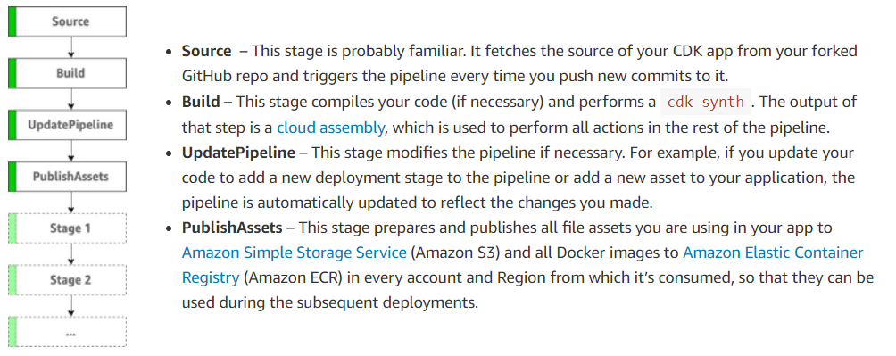
AWS CDK Pipelines
https://aws.amazon.com/blogs/developer/cdk-pipelines-continuous-delivery-for-aws-cdk-applications/

Slide 11
Let's create a CDK pipeline which will deploy our CDK stack, application and test the CDK deployment application

